Slide 1
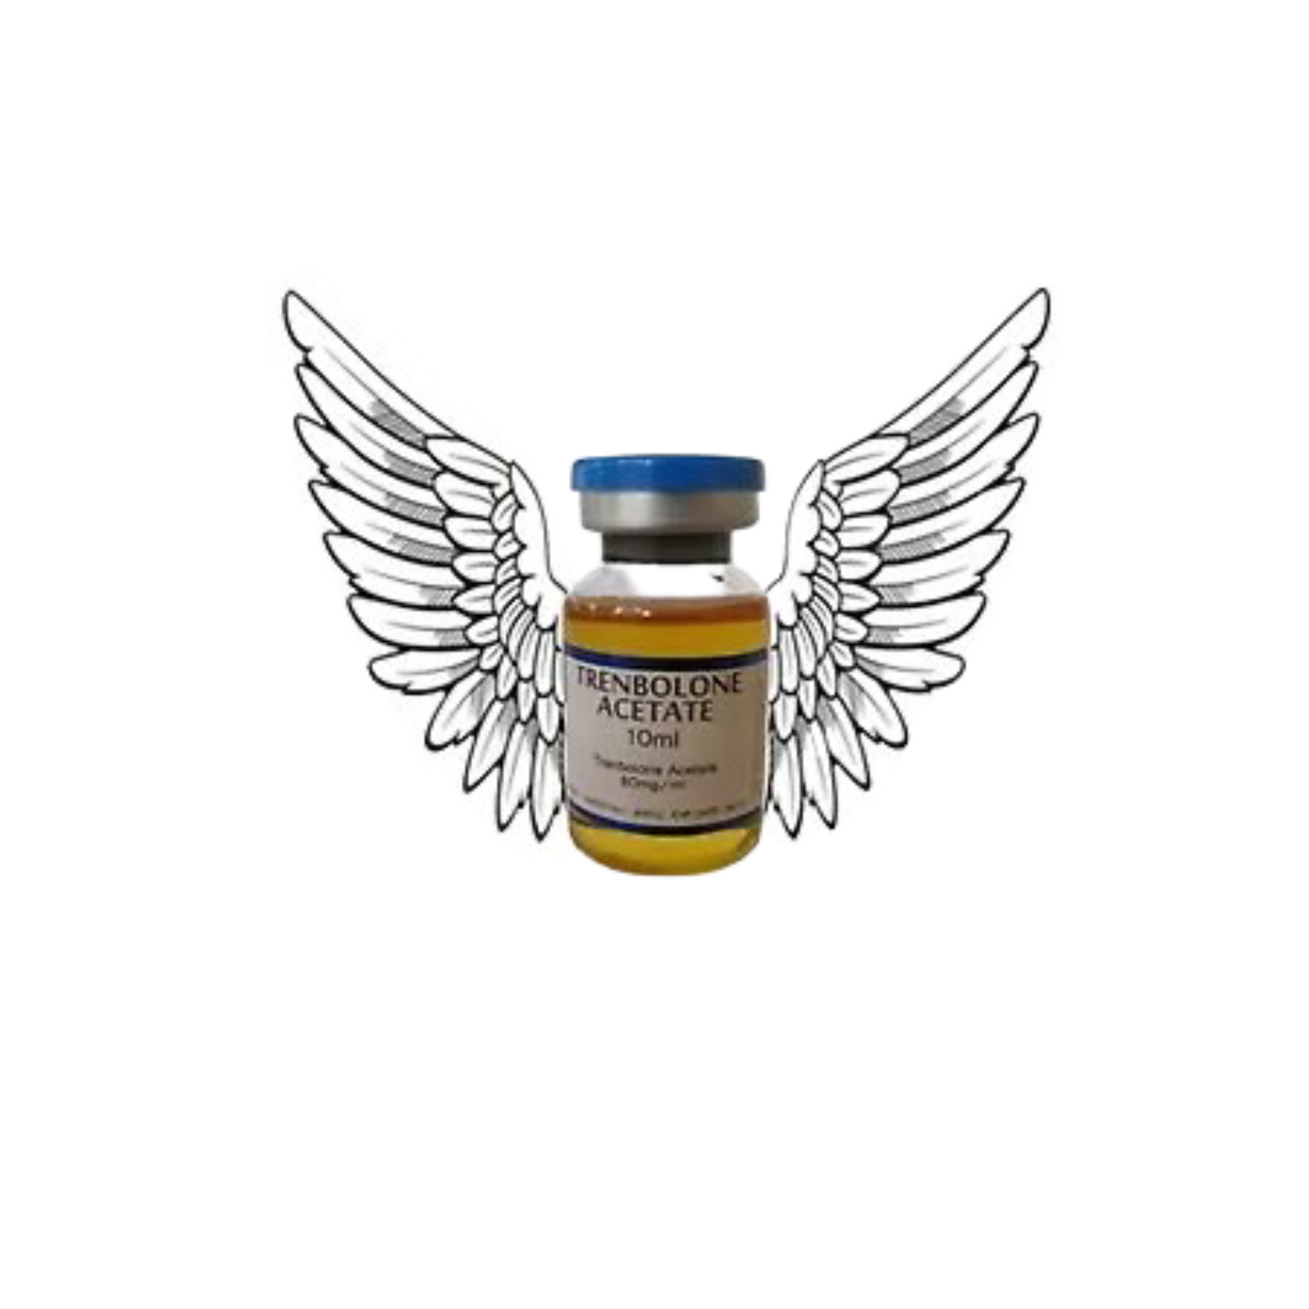
Team
Tren
Sculpting Innovation,
One Rep at a Time.

Slide 2
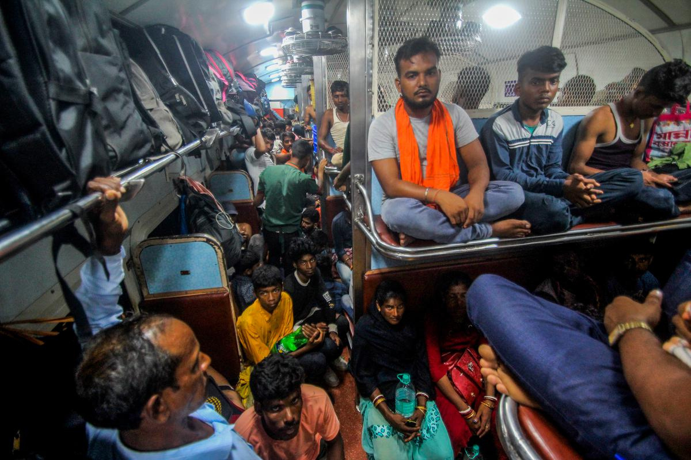
Team Tren
Problem Statement
Indian Railways is a major travel carrier in the country,
crucial for the economy and nation's development. Its main
focus is on providing comfort and convenience to travelers
for various personal and professional reasons. However, Overcrowding has significantly impacted the railway's assets, causing significant damage to its resources, operations and overall condition.

Slide 3
Team Tren
Roots and Impacts
Lack of Accomodation Capacity
Lack of Monitoring Systems and Passanger Immoralities
Individuals board reserved coaches due to a lesser number of coaches, hoping to find a manageable accommodation to their destination.
Due to a lack of recognition of unreserved travelers, people often board trains to secure a confirmed reservation out of grace.
Violence, Stampede
& Threat to Life
Resource
Degradation
Unreserved Overcrowders belittle the situation and board coaches, creating a life-threatening situation which is a threat to security of other passengers as well.
Not only the Physical properties belonging to the railways gets impaired and blemish, but Overcrowding cause other elaborative budgetary misfortune as well.

Slide 4
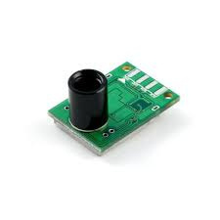
Solution.
Team Tren
An Automated InfraRed Based Passenger Count Detection System inside the coach

Slide 5
Team Tren
संचित
Sanchit
Counted and Accumulated

Slide 6
Applications
Team Tren
  Survillience on Number of Passengers
The number of people entering the coach should be equal to the number of people with permissible entry tickets as per the Ticketing Database for that particular station
  Real time alert of most Dire coaches
Coaches with the worst situations could be targeted by Railway Authority and Security Personnel, and appropriate action would be taken
  Passenger Management for RAC and WLs
Helping authorities checking the reservations, they could ease up their search process of finding eligible allottable seats.

Slide 7
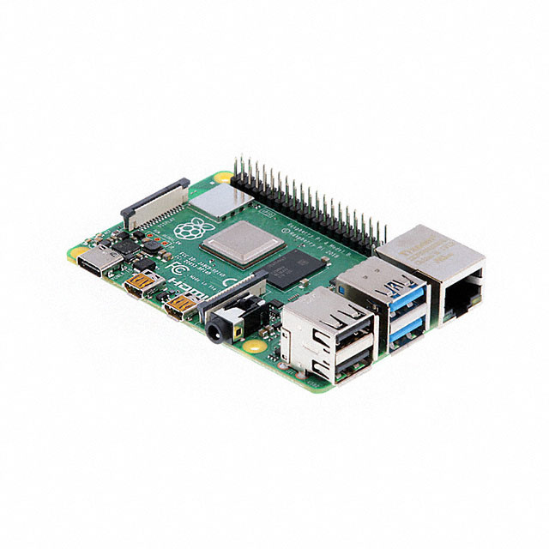
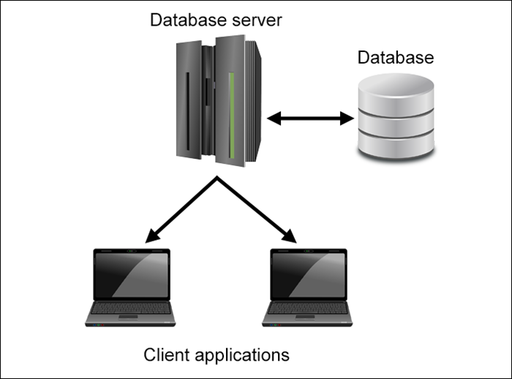

Components
Team Tren
1.
4.
2.
3.
  InfraRed Array Sensor
  Microcontroller (RasberyPi)
  Database Servers
  Controlling and managing Interface

Slide 8
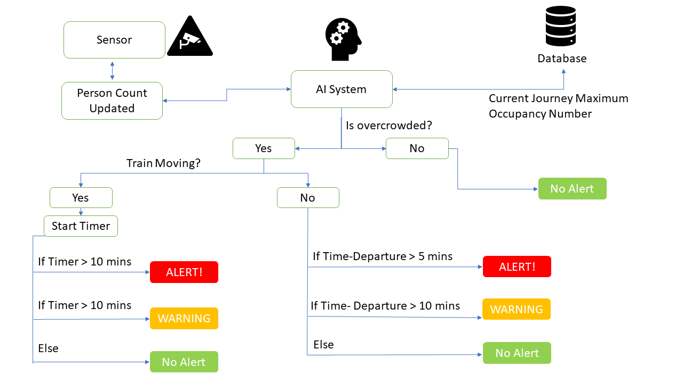
Work Flow
Team Tren

Slide 9
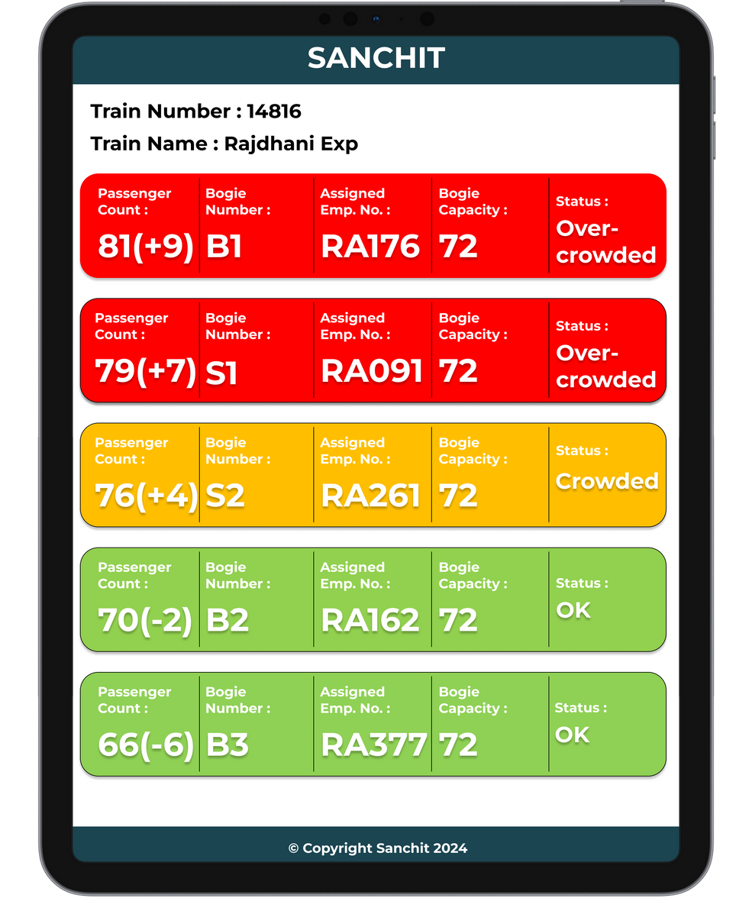
Railway Officials User Interface
Team Tren
Live Monitoring, Analysis, and Assignment of Railway Personnel on Hand-Held Terminal

Slide 10
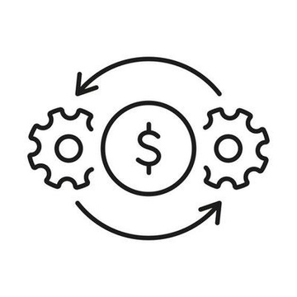
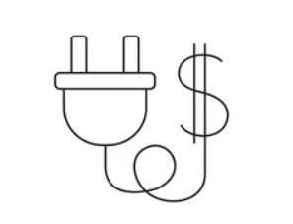

Feasibility and Privacy Friendly
Advantages
  Easy and Low Cost Installation as low as Rs. 2500 per setup.
  Minute Resource consumption.
  Minute Setup spot.
“Budget Friendly”
Energy Efficient
  Consumes less Power and could work with minimalistic supply.
  Could work on Backup power as well.
“Eco-Friendly and Sustainable”
In Conjunction with current Infrastructure
  Could be integrated along with current data setup and infrastructure resources.
  Standardized along with technology accessible to Operational Staff and Security Personnels.
“Easy Integration”

Slide 11
Analysis
Future Scope
Dwell Time and Traffic Patterns by Data Accumulation and Analyzing | Development to an Object Classification System
Automation of seat Reservation for RAC and WL ticket holders | Produce Advanced real-time Data Visuaization

Slide 12
Analysis
Constraints
Missing Human Resource to imply the removal of Unreserved Passengers | Accuracy Challenges
Automation of seat Reservation for RAC and WL ticket holders | Produce Advanced real-time Data Visuaization

